Slide 1
Rabindranath Tagore
Born: 7 May 1861, Jorasanko Thakurbari, Kolkata
Died: 7 August 1941 (age 80 years), Jorasanko Thakurbari, Kolkata

Slide 2
About
Rabindranath Tagore FRAS was a Bengali polymath who worked as a poet, writer, playwright, composer, philosopher, social reformer, and painter of the Bengal Renaissance. He reshaped Bengali literature and music as well as Indian art with Contextual Modernism in the late 19th and early 20th centuries.
Born: 7 May 1861, Jorasanko Thakurbari, Kolkata
Died: 7 August 1941 (age 80 years), Jorasanko Thakurbari, Kolkata

Slide 3
Children: Rathindranath Tagore, Shamindranath Tagore, Renuka Devi, Meera Devi, Madhurilata Devi
Spouse: Mrinalini Devi (m. 1883–1902)
Artworks: Dancing Woman, Woman Face, Head Study (Geometric), Woman's Face, Standing Figure, Veiled Woman, Bird (Fantastic)

Slide 4
What is the golden book of Tagore?
A sumptuous tribute to Tagore on the occasion of his seventieth birthday, The Golden Book of Tagore arose out of the suggestion of acclaimed French writer Romain Rolland. The salutations range from Gandhi, Albert Einstein, Kostes Palama, to Rolland himself.
What was the education of Rabindranath Tagore?
R.N Tagore did not enjoy schooling, and he was mostly found procrastinating and pondering for hours. He went to one of the most prestigious St. Xavier's School, and later, he went to the University of London in Bridgton, England, to study law and become a barrister.

Slide 5
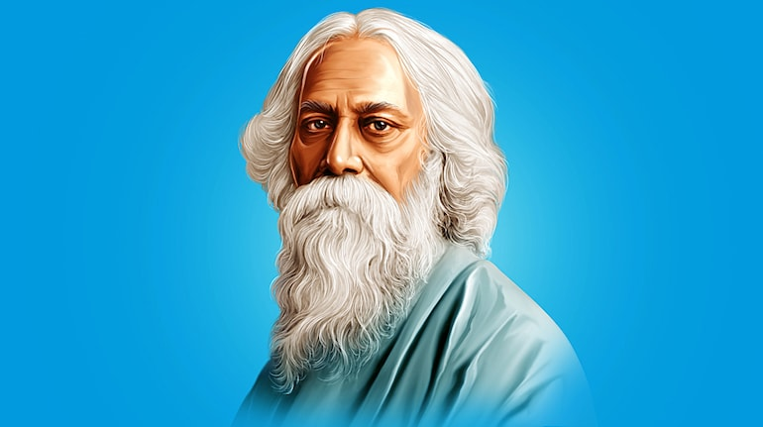
R.N Tagore ji
Born in:7 May 1861, Jorasanko Thakurbari, Kolkata Died: 7 August 1941 (age 80 years), Jorasanko Thakurbari, Kolkata
Rabindranath Tagore

Slide 6
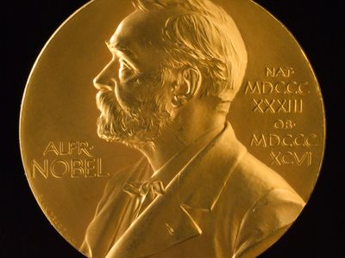
The obverse side of the Nobel Prize medals for Physics, Chemistry, Physiology or Medicine, and Literature
Nobel Prize

